Slide 1

REACT JS
Specialization
.Net 4.5.2, CLR Internals
C# 6.0, WPF 4.5 .2 with Blend
ASP.Net 5,0, ASP.Net MVC 6.0
Linq 4 & ADO.Net EF 7.0
WCF 4.5.1, Web API, WF 4.5.1
Silverlight 5.0 with RIA
Prism 5 with MEF & MVVM
Cloud Computing (Azure)
UML 2 and OOAD
HTML 5, CSS 3, Adv. Javascript
Adv. Jquery , Bootstrap UI
Ext JS 6.0 ,Angular JS, Ember js
React , Flux ,, BackboneJS,
Kendo UI, Jquery UI
Node js, Dust JS, Jade/EJS
65 .Net Design Patterns
Software Architecture
Mocha, QUnit, Jasmine
D.S.R.Murthy M.Tech (IT)
Software Architect & Corporate Trainer
Experience : 24 years

Slide 2
Topics on React JS
Introduction
What is React.js?
What problem does it solve?
Development Eco-System
Editor and Web Server
Browser Development Tools
Hello World Application
JSX
What is JSX?
Using JSX
Using React with JSX
Using React without JSX
Precompiled JSX
Components
Component Life-Cycle
Virtual DOM
Events
State Machines
Compositions
Communication Between Components
Reusable Components
Cloning Components (optional)
Forms
Controlled Components
Uncontrolled Components
ReactLink - Two-Way Data Binding (optional)
Principle of One-Way and Two-Way Data Binding
How it Works
Best Practices
Node.js and Server DOM Manipulation
Unit Testing with TestUtils (optional)
React.js Best Practices
Cross-Browser Issues

Slide 3

React

Slide 4
React
Isomorphic Java script.
Iso-what?
Isomorphic. Javascript means writing one codebase that can run on both the server side and the client side.
This is the concept behind frameworks like Rendr, Meteor & Derby.

Slide 5
React
React is a UI library developed at Facebook to facilitate the creation of interactive, stateful & reusable UI components.
It is used at Facebook and Instagram.com is written entirely in React.
Works both client and server side (Isomorphic JS)
React Goal :
Building large applications with data
that changes over time.

Slide 6
Why React?
Simple
React will automatically manage all UI updates when underlying data changes.
Declarative
When the data changes, React conceptually hits the "refresh" button, and knows to only update the changed parts.
Build Composable Components (DRY) & Testable
React is all about building reusable components with encapsulation to make code reusable, testable (jest) and makes separation of concern.

Slide 7
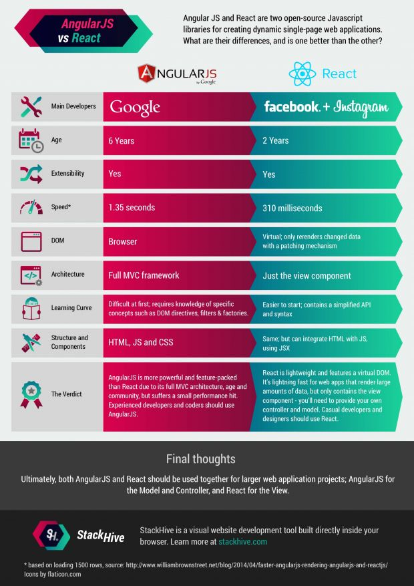
React

Slide 8
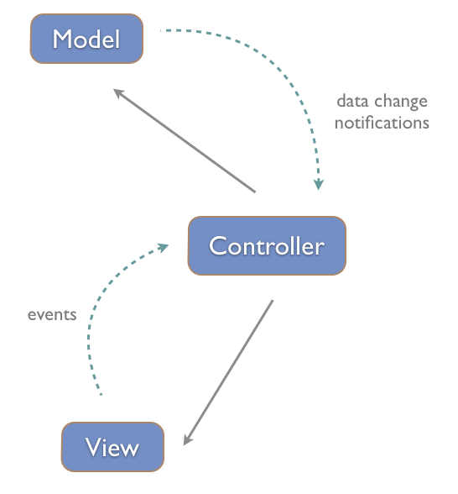
MVC
react

Slide 9
React
React is a JavaScript library for building user interfaces.
Just the UI: Use React as the V in MVC.
Virtual DOM: React uses a virtual DOM diff implementation for ultra-high performance. It can also render on the server using Node.js — no heavy browser DOM required.
Data flow: React implements one-way reactive data flow which reduces boilerplate and is easier to reason about than traditional data binding.

Slide 10
React – Virtual DOM
React uses a concept of Virtual DOM (like byte code in java or IL code in .Net) that selectively renders sub-trees of nodes based upon state changes.
It does the least amount of DOM manipulation possible in order to keep your components up to date.
React applies changes by running a “diffing” algorithm, which identifies what has changed.
The second step is “reconciliation”, where it updates the DOM with the results of diff.

Slide 11
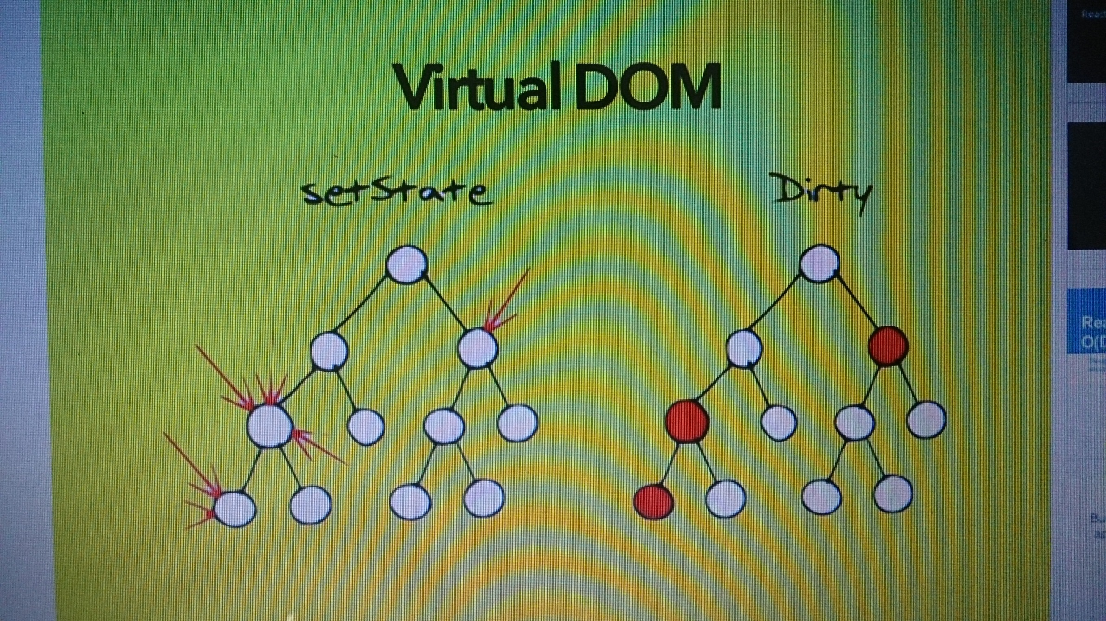
React

Slide 12
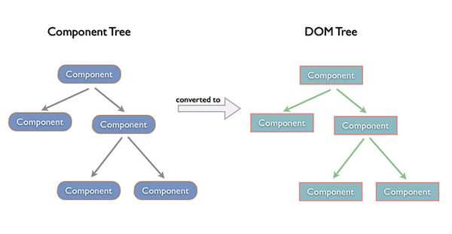
React

Slide 13
React - JSX
JSX (Java Script and Xml) to create JavaScript objects using HTML syntax. To generate a link in React using pure JavaScript :
React.createElement('a',
{href: 'https://facebook.github.io/react/'}, 'Hello!')
With JSX this becomes:
<a href="https://facebook.github.io/react/">Hello!</a>
So JSX is not required to use React.

Slide 14
React - Component
Components are reusable piece of code with first argument we want to render, and the second is the DOM node it should mount to.
Use createClass to create component
var MyComponent = React.createClass({
render: function(){
return (
<h1>Hello, world!</h1>
);
}});
React.render( <MyComponent/>, document.getElementById
('myDiv'));

Slide 15
React - Setup
Node js :
Install Node js & npm
http://www.nodejs.org
> node -v
> npm -v
install express to work with web server
>npm install -g express
>npm install –g express-generator
>express myapp

Slide 16
React
React 0.13/0.14 changes :
The /** @jsx React.DOM */ header is no longer required when writing JSX syntax.
renderComponent is now render
renderComponentToString is now renderToString
https://facebook.github.io/react/downloads.html
bower install --save react

Slide 17
React - CDN
<script src="https://fb.me/react-0.14.0.js"></script>
<script src="https://fb.me/react-dom-0.14.0.js"></script>
React with Add-ons :
<script
src="https://fb.me/react-with-addons-0.14.0.min.js">
</script>
<script
src="https://fb.me/react-dom-0.14.0.min.js">
</script>
$ bower install --save react
https://facebook.github.io/react/downloads.html

Slide 18
React - IDE
Integrated Development Environment : - IDE
Sublime Text 3.0
Eclipse
Visual Studio

Slide 19
React - IDE
The following ST3 plugins are need for React development:
babel - for jsx syntax highlighting
sublime-jshint - for linting js code
sublime-jsxhint - for linting jsx code
Install babel
Find babel in package control and install it.
To use the Babel's JSX syntax highlight :
open up a .jsx file in ST3
Goto 'View -> Syntax -> Open all current extention as ...
> Babel > Javascript (Babel)

Slide 20
React - IDE
Install React Chrome plugin
Install this plugin for Chrome , go to this link and install.
Once installed, open up Extensions find the
React plugin and check the Allow access to file URLS.
This is important to test React files locally.
A webpage using React, an extra tab named React
should appear in Developer Tools.

Slide 21
React - IDE
Convert JSX files to JS files
React uses a syntax called JSX.
To use it in webpage, convert it to regular JS format first.
2 ways :
1. Use the 'JSXTransformer.js'
(which comes with React.js download) to do the conversion
2. Use the 'react-tools' npm package to perform the conversion

Slide 22
React - IDE
Write JSX code inside the HTML page, then use
JSXTransformer.js like this:
<html>
<body>
<script src="js/vendor/react.min.js"></script>
<script src="js/vendor/JSXTransformer.js"></script>
<script type="text/jsx">
...React code inside...
</script>
</body>
</html>

Slide 23
React - IDE
This is good for debugging but not good for production.
Because compiling from .jsx to .js takes time.
To precompile the .jsx files to regular .js files:
How to compile .jsx files?
Install the 'react-tools' package via npm:
npm install -g react-tools

Slide 24
React - IDE
Go into dev directory and use this command:
Assuming this is the structure of your dev directory
dev_dir/
js/
src/
build/
>cd dev_dir/js
>jsx -w src/ build/
This command means watching all .js files inside the src folder and compile them if modified to regular .js files and save them to the build folder.

Slide 25
React - IDE
XMLHttpRequest cannot load
<html>
<body>
<script src="js/react.min.js"></script>
<script src="js/JSXTransformer.js"></script>
<script type="text/jsx" src="react_module.jsx"></script>
</body>
</html>
Observe an error in Chrome's console: XMLHttpRequest cannot load, this is because the JSXTransformer.js loads jsx files via XHR which is prohibited for local files

Slide 26
React - IDE
Install JS linters
npm install -g jshint jsxhint
Install JS linter plugins for ST3
Make sure you have sublime-linter installed first:
- open up package control,
ctrl+shift+p on Linux/Windows
- type 'install' and select 'Package Control: Install Packages'
- type 'SublimeLinter‘
Then, proceed to install both
SublimeLinter-jshint and SublimeLinter-jsxhint.

Slide 27
React - IDE
Linting config for JSX
{
// Environments - these prevent warnings about the use of some global
// variables. e.g. 'browser' assumes a 'window' global is available, etc.
"browser": true,
"browserify": true,
"devel": true,
// Var names must be camelCase or UPPER_CASE
"camelcase": true,
// Loops and conditionals must have curly brackets
"curly": true,
// Allow ES6 features
"esnext": true,
// 4 space indent (does not create warnings)
"indent": 4,
// Constructor functions must be capitalised
"newcap": true,
// Prevent use of undefined variables
"undef": true,
// Warn about unused variables
"unused": true,
//Avoid the 'React could not be found' error, also ignore $ error if you use jquery
"globals": {
"React": false,
"$": false
}
}
Save this file as .jshintrc and place it in your project folder and restart Sublime Text 3 to see the linting options being applied to .JSX files.

Slide 28
React
Setup React environment with node and express
Demo

Slide 29
JSX

Slide 30
COMPONENTS

Slide 31
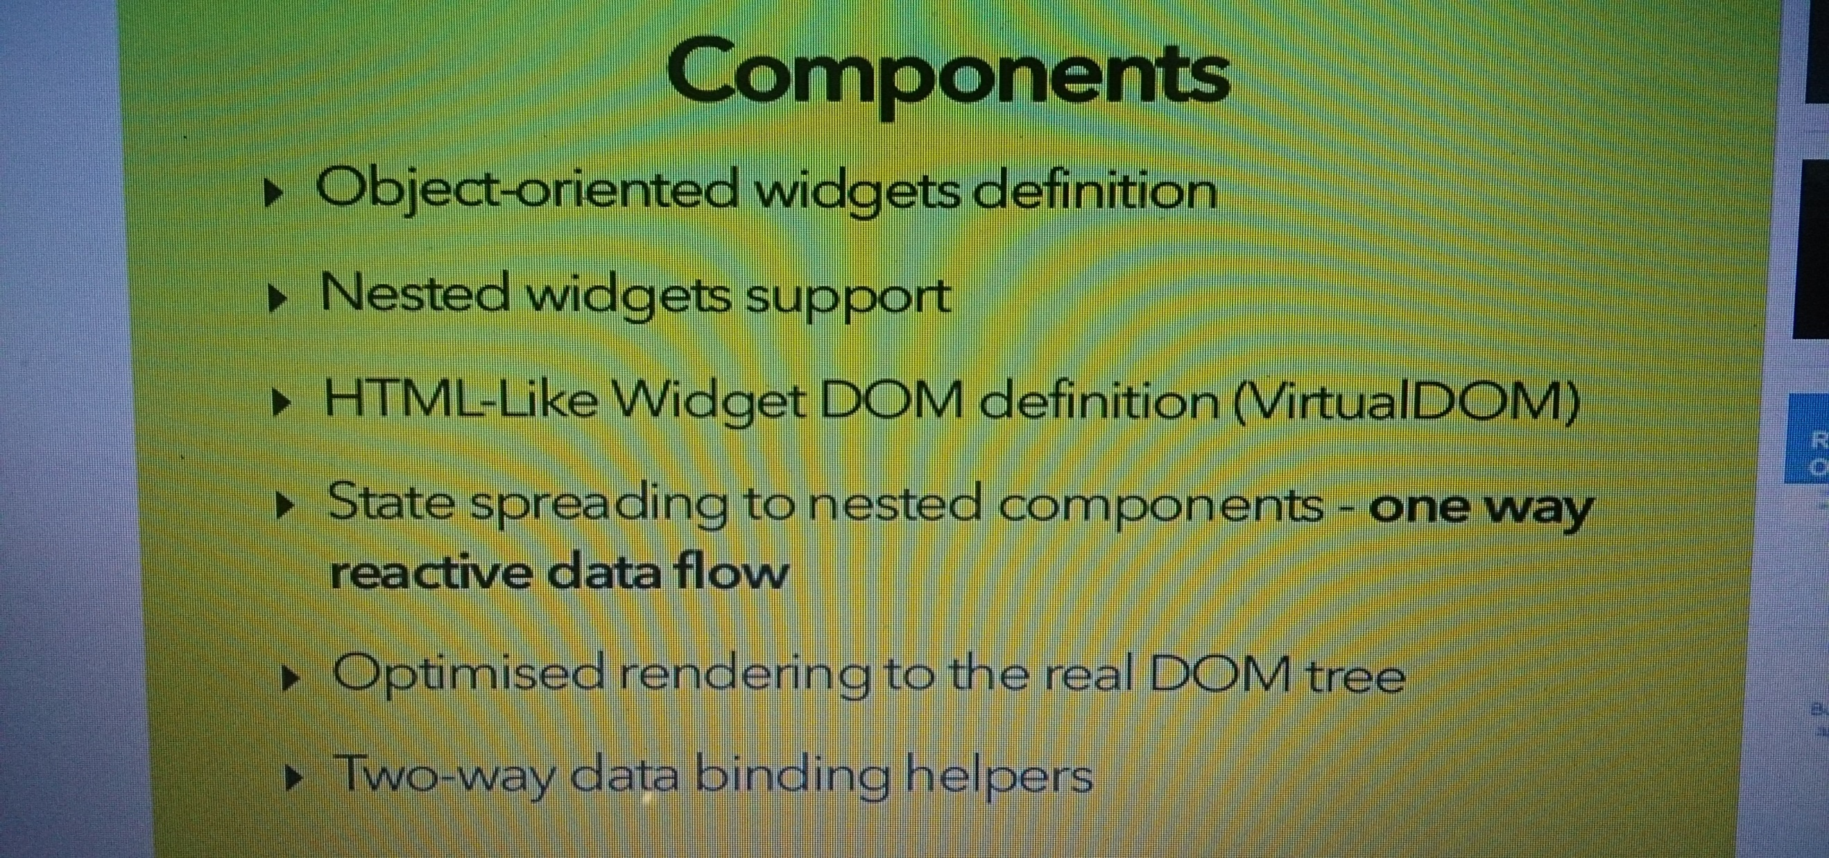
React

Slide 32
React
Reactive Updates
React uses a fast, internal mock DOM to perform diffs and computes the most efficient DOM mutation .
The inputs to this component are called props — short for "properties".
They're passed as attributes in JSX syntax.
JSX = HTML + javascript in XML way

Slide 33
React
Components are Just Like Functions
Note:
One limitation:
React components can only render a single root node. To return multiple nodes they must be
wrapped in a single root.

Slide 34
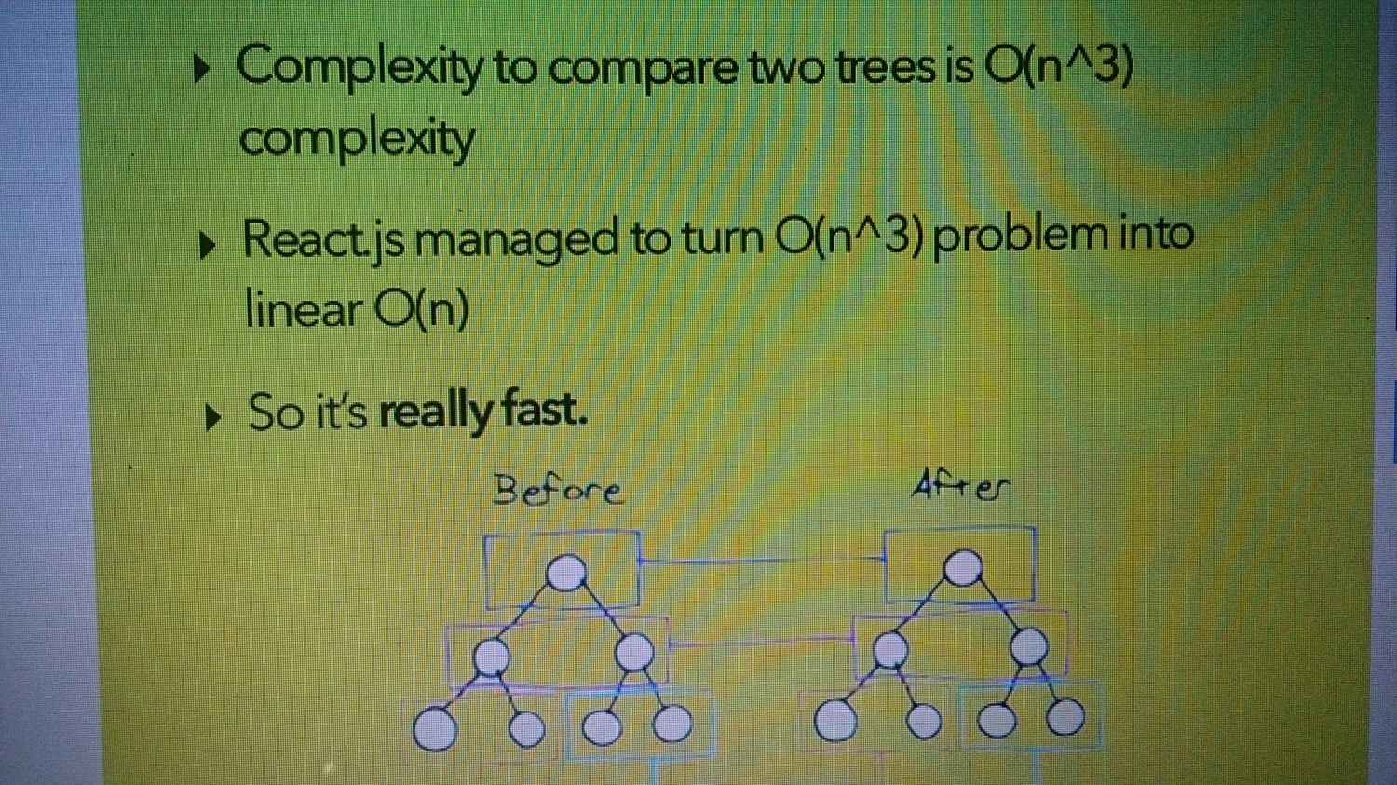
React

Slide 35
React
With React, the View-part of the MVC is rolled into an entity called the Component.
The Component maintains an immutable property bag called props, and a state that represents the user-driven state of the UI.
Instead of constructing a physical DOM directly from a template file/script/function, the Component generates an intermediate DOM that is a stand-in for the real HTML DOM. (Virtual DOM)
An additional step is then taken to translate this intermediate DOM into the real HTML DOM.

Slide 36
React
React’s basic building blocks are called components.
var Hello = React.createClass({
render: function() {
return (
<div>Hello, {this.props.name} !</div>;
)
}
});
React.render(new Hello({name:”sri” } ), document.body);
Or
React.render(<Hello name=“sri”/>,
document.body);

Slide 37
React – Controlled Component
An <input> with value set is a controlled component. In a controlled <input>, the value of the rendered element will always reflect the value prop.
render: function() {
return <input type="text" value="Hello!" />;
}
This will render an input that always has a value of Hello!.
Any user input will have no effect on the rendered element because React has declared the value to be Hello!.

Slide 38
React – Controlled Component
To update the value in response to user input, use the onChange event:
getInitialState: function() {
return {value: 'Hello!'}; },
handleChange: function(event) {
this.setState({value: event.target.value});
}, render: function() {
var value = this.state.value;
return <input type="text" value={value} onChange={this.handleChange} />;
}

Slide 39
React – Controlled Component
Here we are accepting the newest value provided by the user and updating the value prop of the <input> component.
This pattern makes it easy to implement interfaces that respond to or validate user interactions.
For example:
handleChange: function(event) {
this.setState({value: event.target.value.substr(0, 140)});
}
This would accept user input but truncate the value to the first 140 characters.
.

Slide 40
React – Controlled Component
Why Controlled Components?
Using form components such as <input> in React presents a challenge that is absent when writing traditional form HTML.
For example, in HTML:
<input type="text" name="title" value="Untitled" />
This renders an input initialized with the value, Untitled. When the user updates the input, the node's value property will change.
However, node.getAttribute('value') will still return the value used at initialization time, Untitled.

Slide 41
React – Controlled Component
Unlike HTML, React components must represent the state of the view at any point in time and not only at initialization time.
For example, in React:
render: function() {
return <input type="text" name="title" value="Untitled" />; }
Since this method describes the view at any point in time, the value of the text input should always be Untitled..

Slide 42
React – Uncontrolled Component
Uncontrolled Components
An <input> that does not supply a value (or sets it to null) is an uncontrolled component.
In an uncontrolled <input>, the value of the rendered element will reflect the user's input.
render: function() { return <input type="text" />; }
This will render an input that starts off with an empty value. Any user input will be immediately reflected by the rendered element. If you wanted to listen to updates to the value, use the onChange event.
.

Slide 43
React
Default Value
To initialize the component with a non-empty value, supply a defaultValue prop.
render: function() {
return <input type="text" defaultValue="Hello!" />; }
This example will function much like the Controlled Components
<input> supports defaultChecked
<select> supports defaultValue.
.

Slide 44
React
Props : readonly properties in react used in components to update UI
State : used to mutate the component state to reflect changes in DOM
When do you use props or state, or even just private variables?
Props are used for passing data between child and parent React classes, and any changes to a prop cause an automatic rerender of the view, both parent and child.
For data that’s relevant only to the view and nothing else, use state. Any changes here also rerender the view.
For any data that’s pertinent to the class but not the view itself, you could use a private variable

Slide 45
React – Lifecycle methods
Components have three main parts of their lifecycle:
1. Mounting: A component is being inserted into the DOM.
2. Updating: A component is being re-rendered to determine if the DOM should be updated.
3. Unmounting: A component is being removed from the DOM.

Slide 46
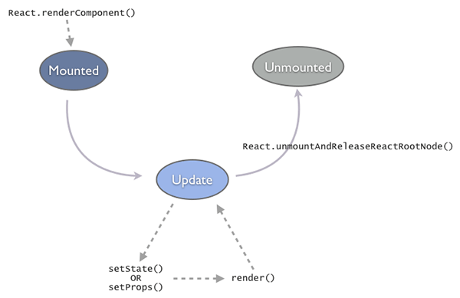
React – Lifecycle methods

Slide 47
React – Lifecycle methods
The Component comes to life after being Mounted.
Mounting results in going through a render-pass that generates the component-tree (intermediate-DOM).
This tree is converted and placed into a container-node of the real DOM.
This is a direct outcome of the call to React.render().

Slide 48
React – Lifecycle methods
Once mounted, the component stays in the Update state.
A component gets updated when we change state using setState().
This in turn results in calling render(), which brings the DOM in sync with the data (props + state).
Between subsequent updates, React will calculate the delta between the previous component-tree and the newly generated tree to optimize and minimizes the manipulation on the real DOM.

Slide 49
React – Lifecycle methods
The final state is Unmounted.
This happens when we explicitly call React.unmountAndReleaseReactRootNode() or automatically if a component was a child that was no longer generated in a render() call.
React tell when it moved between the Mounted-Update-Unmounted states using built-in methods

Slide 50
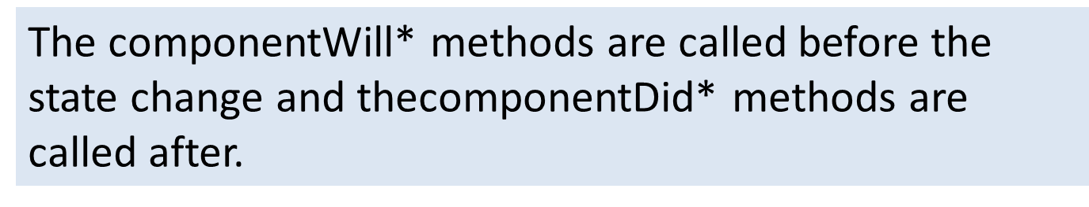
React – methods
Mounting methods :
getInitialState(): object is invoked before a component is mounted. Stateful components should implement this and return the initial state data.
componentWillMount() is invoked immediately before mounting occurs.
componentDidMount() is invoked immediately after mounting occurs.
Initialization that requires DOM nodes should go here.

Slide 51
React – Lifecycle methods
Updating methods:
componentWillReceiveProps(object nextProps) is invoked when a mounted component receives new props. This method should be used to compare this.propsand nextProps to perform state transitions using this.setState().
shouldComponentUpdate(object nextProps, object nextState): boolean is invoked when a component decides whether any changes warrant an update to the DOM.
Implement this as an optimization to compare this.props with nextProps andthis.state
with nextState and return false if React should skip updating.

Slide 52
React – Lifecycle methods
Updating methods:
componentWillUpdate(object nextProps, object nextState) is invoked immediately before updating occurs. You cannot call this.setState() here.
componentDidUpdate(object prevProps, object prevState) is invoked immediately after updating occurs.
.

Slide 53
React – Lifecycle methods
Unmounting
componentWillUnmount() is invoked immediately before a component is unmounted and destroyed. Cleanup should go here.
Mounted Methods
findDOMNode(): DOMElement can be invoked on any mounted component in order to obtain a reference to its rendered DOM node.
forceUpdate() can be invoked on any mounted component when we know that some deeper aspect of the component's state has changed without using this.setState().
.

Slide 54
React - prop
Component can contain attributes called props.
this.props is used in render method to render dynamic data:
var MyComponent = React.createClass({
render: function(){
return (
<h1>Hello, {this.props.name}!</h1>
);
}});
React.render(<MyComponent name="Handsome" />, document.getElementById('myDiv'));

Slide 55
React – Specs, Lifecycle, State
Specs
getInitialState – Return value is the initial value for state.
getDefaultProps – Sets fallback props values if props aren’t supplied.
mixins – An array of objects, used to extend the current component’s functionality.

Slide 56
React – State
State
Every component has a state object and a props object.
State is set using the setState method.
Calling setState triggers UI updates.
getInitialState method used to set initial state.

Slide 57
React – State
Within a component-tree, data should always flow down.
A parent-component should set the props of a child-component to pass any data from the parent to the child.
This is termed as the Owner-Owned pair.
user-events (mouse, keyboard, touches) will always bubble up from the child all the way to the root component, unless handled in between.

Slide 58
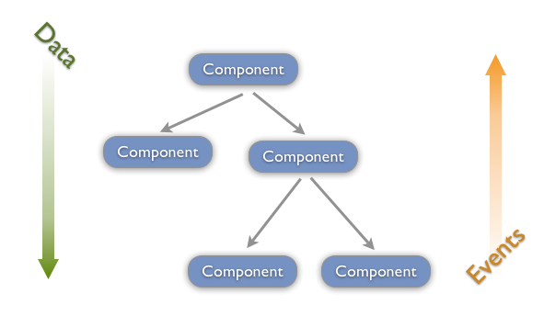
React –

Slide 59
React – State
Unidirectional Data Flow
In React, application data flows unidirectionally via the state and props objects, as opposed to the two-way binding of libraries like Angular.
In a multi component heirachy, a common parent component should manage the state and pass it down the chain via props.
state should be updated using the setState method to ensure that a UI refresh will occur.
The resulting values should be passed down to child components using attributes that are accessible in said children via this.props.

Slide 60
React – ref
The ref String Attribute
React supports a very special property that can be attached to any component that is output from render().
This special property allows to refer to the corresponding backing instance of anything returned from render(). It is always guaranteed to be the proper instance, at any point in time.

Slide 61
React – ref
The ref String Attribute
Assign a ref attribute to anything returned from render such as:
<input ref="myInput" /> In some other code (typically event handler code), access the backing instance via this.refs as in:
this.refs.myInput : can access the component's DOM node directly
React.findDOMNode(this.refs.myInput).

Slide 62
React – ref
The ref String Attribute
render: function() {
return (
<TextInput
ref={function(input) {
if (input != null) {
input.focus();
}
}} />
);
}, (refddemo.html)

Slide 63
React - ref
create the intermediate-DOM in render(), to assign a ref property to a child component then refer to it from the parent using the refs property.
render: function(){ // Set a ref
return (
<div> <span ref="counter"
class="count">{this.state.count}</span> </div>;
)}
handleMouseDown: function(){ // Use the ref console.log(this.refs.counter.innerHTML);
},

Slide 64
React - ref
The ref Callback Attribute
The ref attribute can be a callback function instead of a name.
This callback will be executed immediately after the component is mounted.
The referenced component will be passed in as a parameter, and the callback function may use the component immediately, or save the reference for future use (or both).

Slide 65
React
React Addons
https://github.com/STRML/react-addons

Slide 66
React – Two Way Data Binding
Two way data binding without Reactlink:
var NoLink = React.createClass({
getInitialState: function() {
return {message: 'Hello!'};
},
handleChange: function(event) {
this.setState({message: event.target.value});
}, render: function() {
var message = this.state.message;
return <input type="text" value={message} onChange={this.handleChange} />; }
});

Slide 67
React – Two Way Data Binding
Two way data binding with ReactLink :
var WithLink = React.createClass({
mixins: [React.addons.LinkedStateMixin],
getInitialState: function() {
return {message: 'Hello!'};
},
render: function() {
return <input type="text" valueLink={this.linkState('message')} />;
}
});

Slide 68
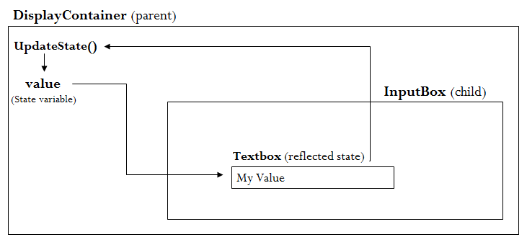
React – Two Way Data Binding
The ‘DisplayContainer’ will display a state variable of it and ‘InputBox’ will be a child of ‘DisplayContainer’, which will have a textbox in it.
Murthy
Demo: Two way data binding

Slide 69
React – Cross Browser
Polyfills Needed to Support Older Browsers
es5-shim.js from kriskowal's es5-shim provides the following that React needs:
Array.isArray
Array.prototype.every
Array.prototype.forEach
Array.prototype.indexOf
Array.prototype.map
Date.now
Function.prototype.bind
Object.keys
String.prototype.split
String.prototype.trim

